Slide 1

Services, DI & Routing
Curs 5:

Slide 2
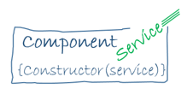
Services
Any function, or feature that an app needs
Typically a class with a narrow, well-defined purpose
Used to increase modularity and reusability
Also referred as injectable service classes

Slide 3

Dependency Injection (DI)
Dependencies = services or objects that a class needs to perform its function
DI = a coding pattern in which a class asks for dependencies from external sources rather than creating them itself
Used to inject a service into a component, giving the component access to that service class
To define a class as a service in Angular, use the @Injectable() decorator
You must register at least one provider of any service you are going to use

Slide 4

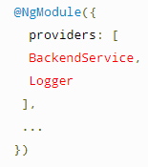
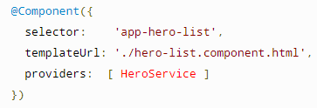
Providing services
A provider is an object that tells an injector how to obtain or create a dependency.
Ways to register providers:
In the @Injectable() decorator for the service itself
In the @NgModule() decorator for an NgModule
In the @Component() decorator for a component

Slide 5
Routing & Navigation
The Angular Router enables navigation from one view to the next as users perform application task
It imitates the browser model
can interpret a browser URL as an instruction to navigate to a client-generated view
can pass optional parameters along to the supporting view component
can navigate when the user clicks a button, selects from a drop box etc.
can log activity in the browser's history journal

Slide 6
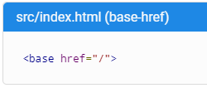
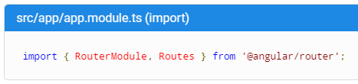
Routing implementation
Tell the router how to compose navigation URLs
Import Angular Router service

Slide 7
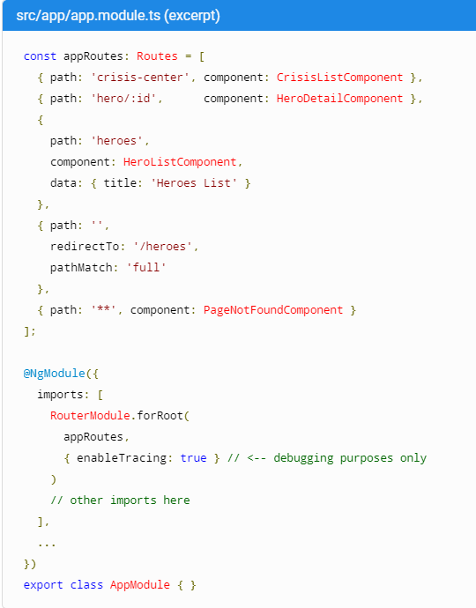
Routing implementation
configures the router via the RouterModule.forRoot() method
adds the result to the AppModule's imports array

Slide 8

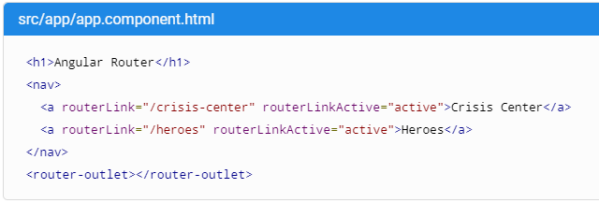
Routing implementation
Add the RouterOutlet directive in the template where the router should display the components for that outlet
Add the RouterLink directives on the anchor tags, to navigate
RouterLinkActive directive: what css classes should we have on the corresponding navigation element

Slide 9
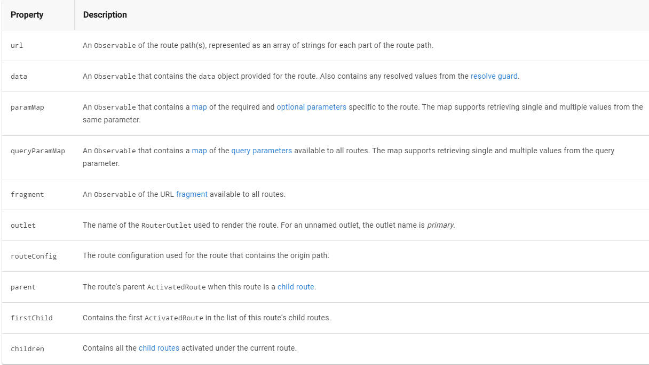
Routing implementation
ActivatedRoute = service which gives us details about the current route.
Can be injected into our components.

Slide 10
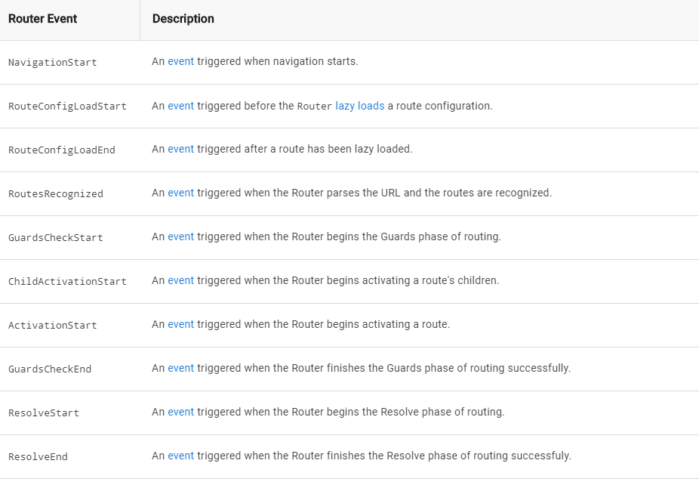
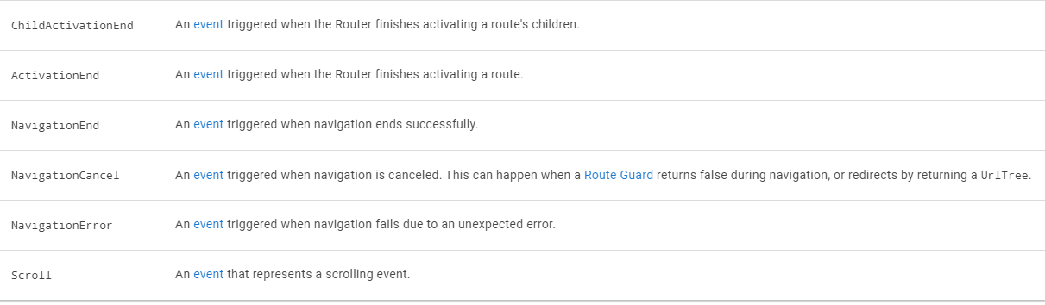
Router Events
Yes, router has events as well. ( many events )
We can access them from the router service
Inject Router into the component and subscribe to the events

Slide 11
References
Dependency Injection:
https://angular.io/guide/architecture-services
https://angular.io/guide/dependency-injection
Router:
https://angular.io/guide/router
https://angular.io/guide/router#active-router-links
https://angular.io/guide/router#router-events

